Slide 1
In Fill Gain Corrections: E/p vs Laser Sam Grant Europa omega_a Meeting 5th July 2019

Slide 2
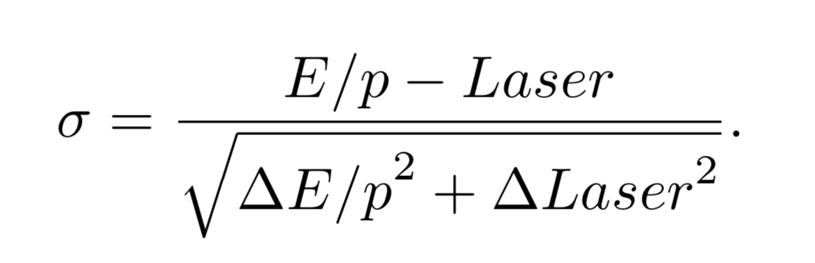
Overview
Derive the recovery times and amplitudes using E/p
Quantify the level of deviation between laser and E/p:
We can use the pull per crystal in units of sigma
As well as the fractional uncertainty per crystal

Slide 3
Cuts on fits per crystal
//QUALITY CUTS
// Require high stats
if (N < 50000) continue;
// Require reasonable reduced chi squared
if(chiSqrNDF < 0.25 || chiSqrNDF > 4) continue;
// Require low error
if( tau_err > 0.5*tau || A_err > 0.5*A) continue;

Slide 4
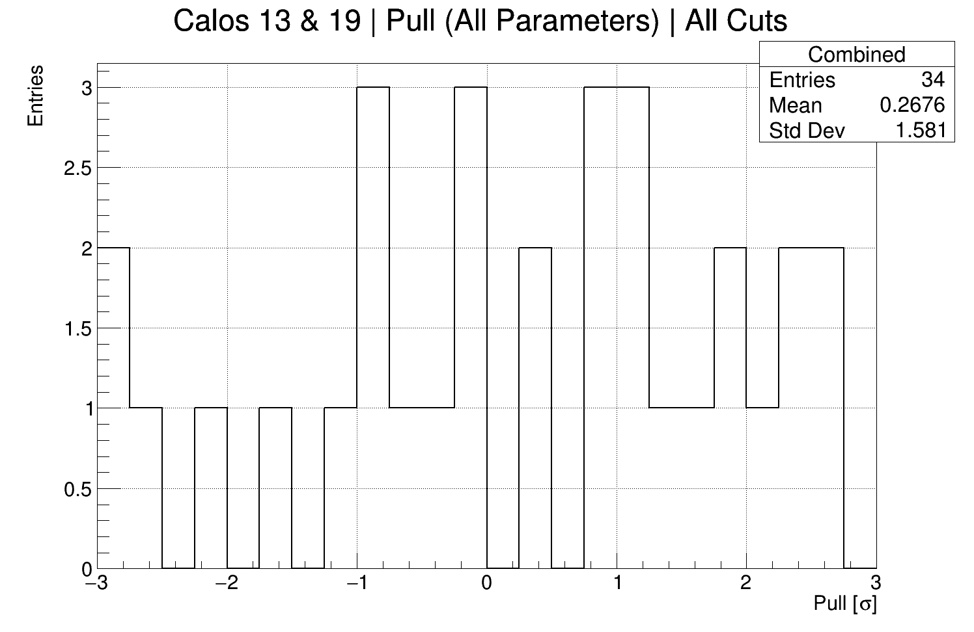
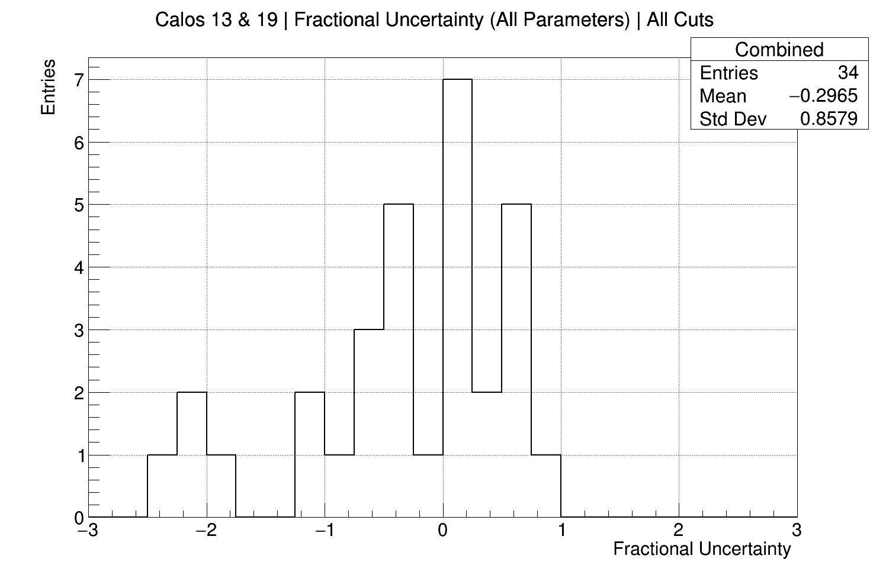
Cuts Illustration (1D Distributions)
You might expect a nice gaussian, with sigma = the percentage uncertainty of the laser results...
Why are there outliers?

Slide 5
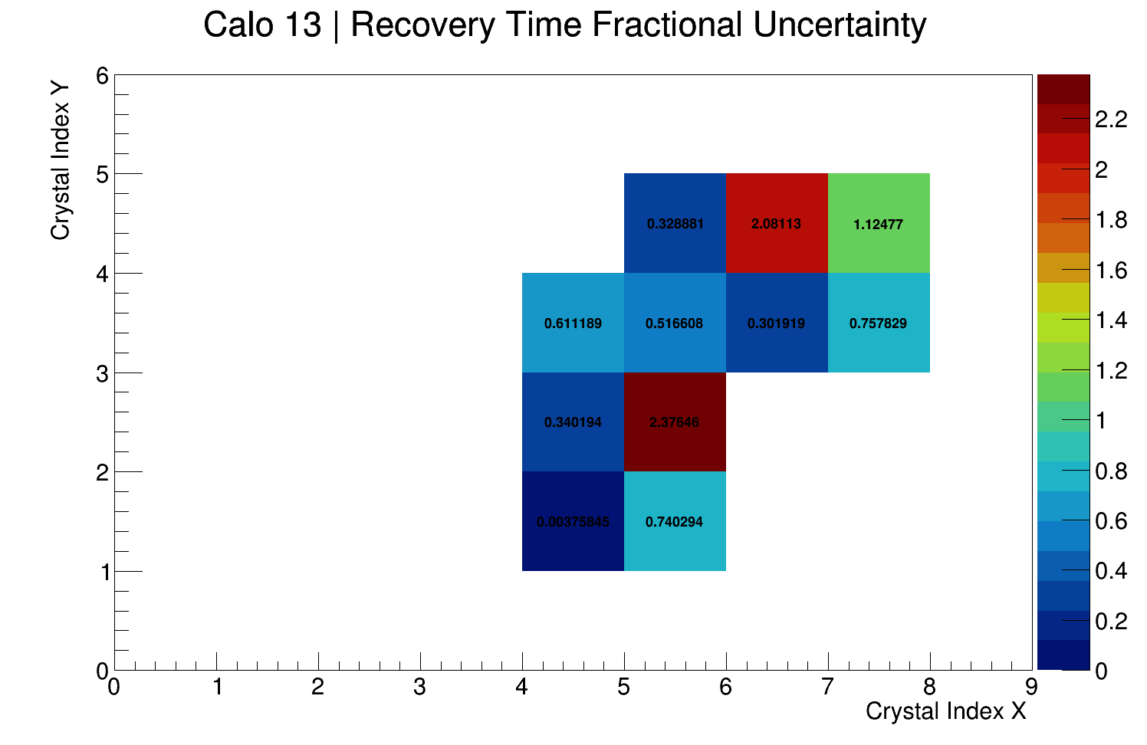
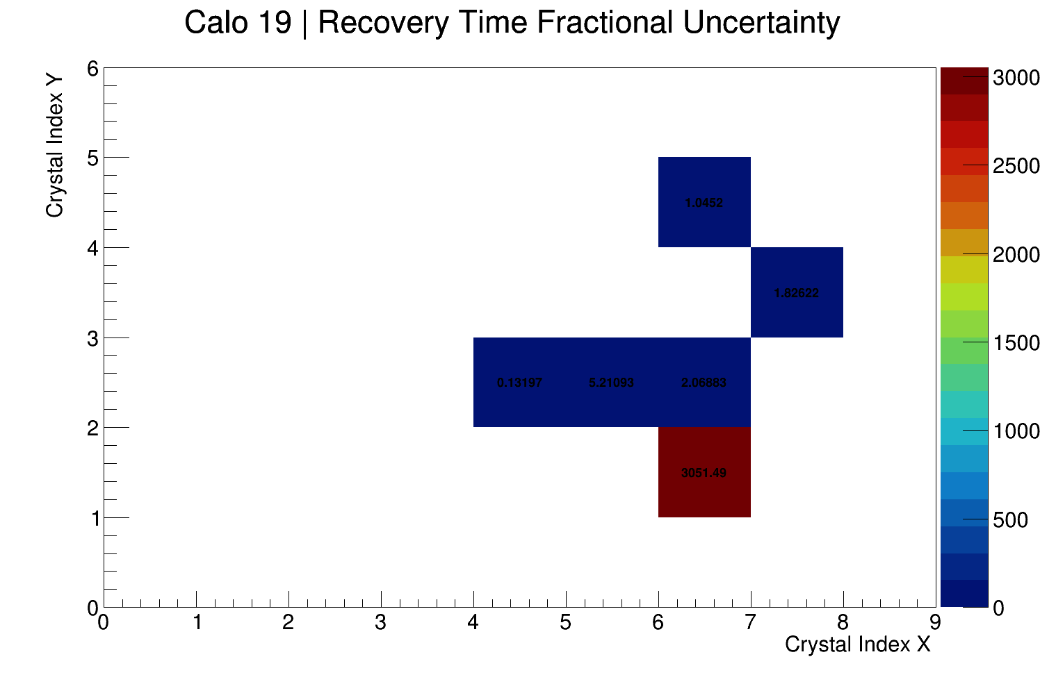
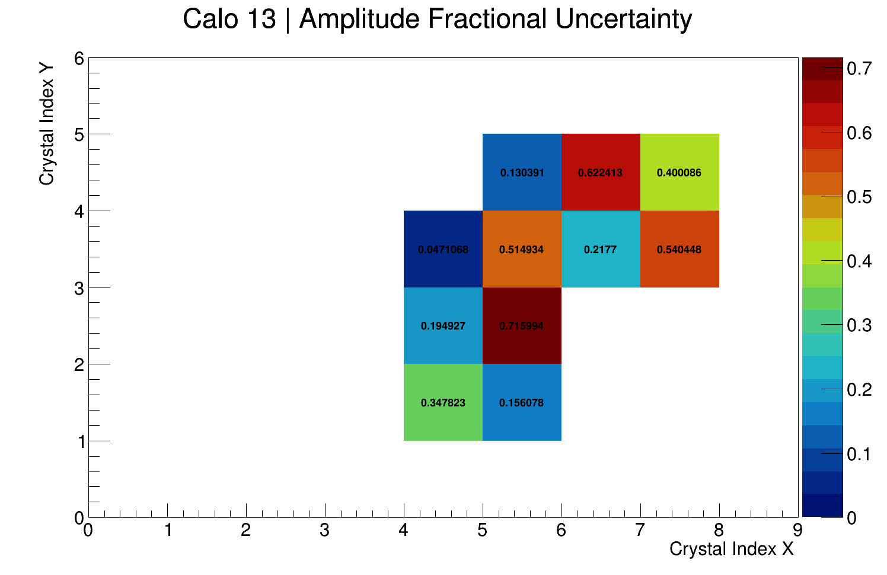
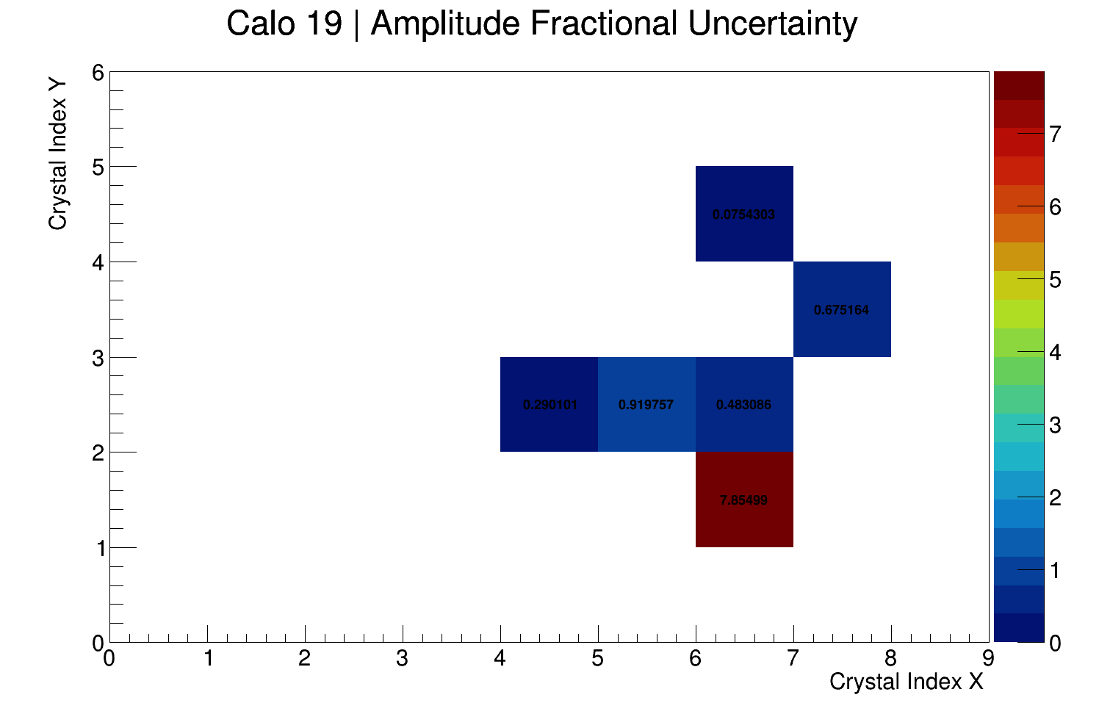
Good Crystal (Calo 13 #22) vs. Bad Crystal (Calo 19 #15)

Slide 6
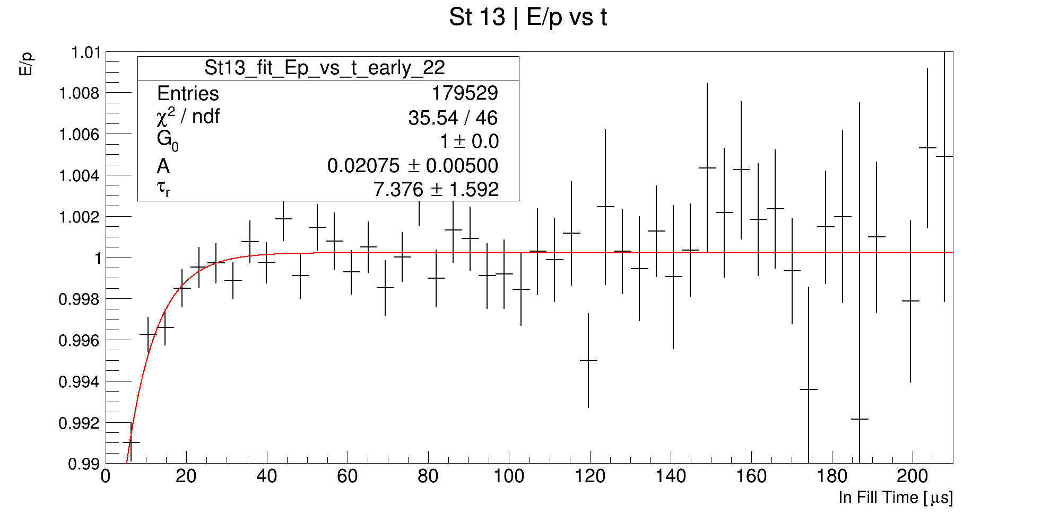
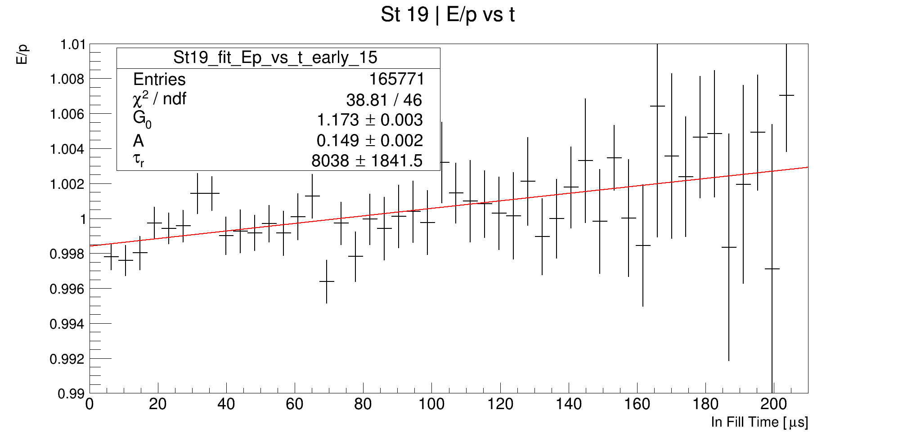
Good Crystal (Calo 13 #22) vs. Bad Crystal (Calo 13 #42)
Idea: Focus on *very* early time < 60 us. Maybe variation at later times when we lose stats is ruining the fits

Slide 7
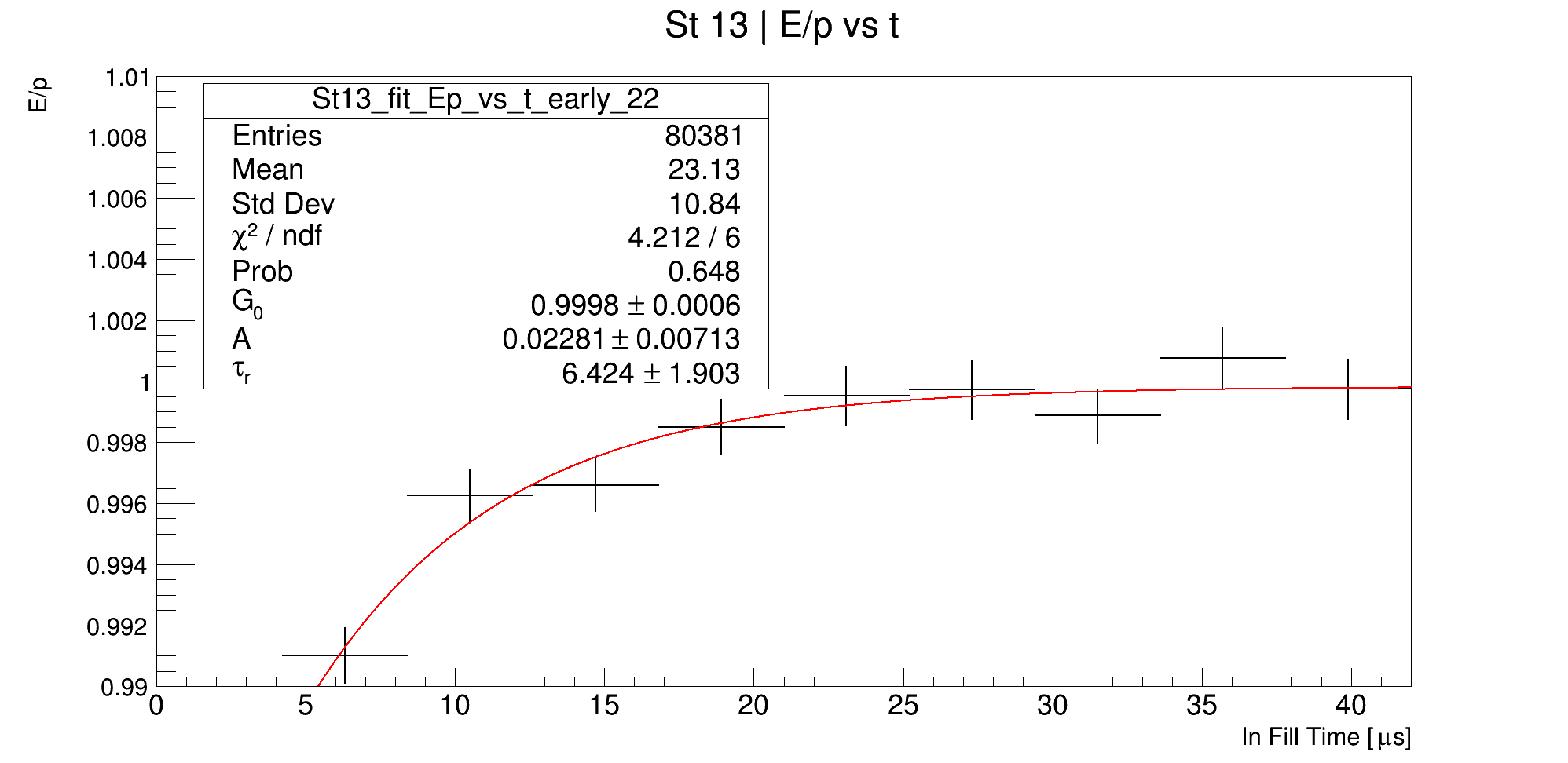
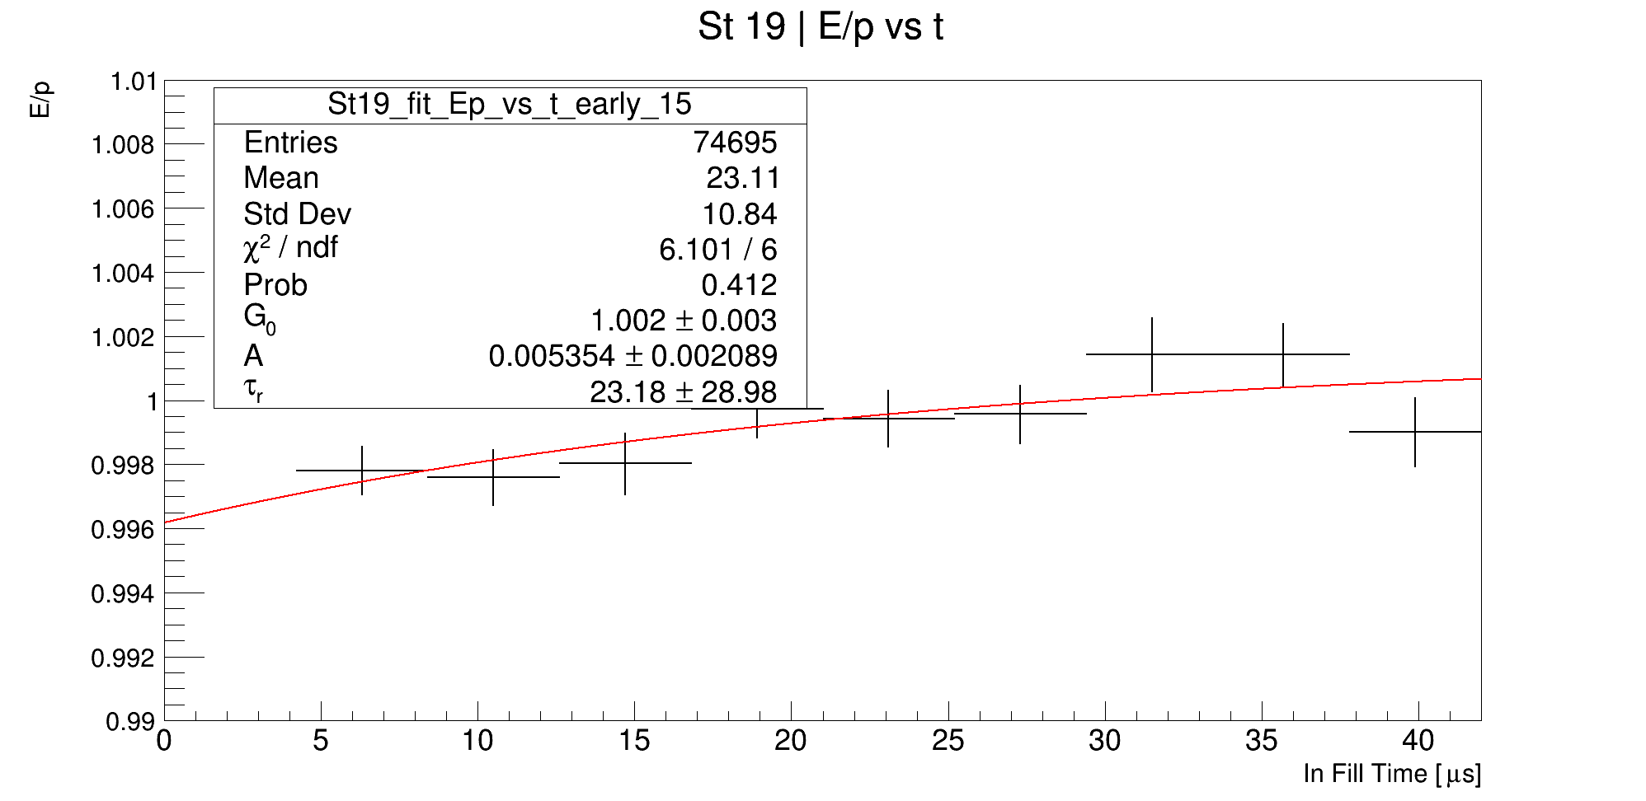
Good Crystal (Calo 13 #22) vs. Bad Crystal (Calo 13 #42)
Idea: Focus on *very* early time > 60 us. Maybe variation at later times when we lose stats is ruining the fits.
Drives up the relative uncertainty on the time constant, which is good!

Slide 8
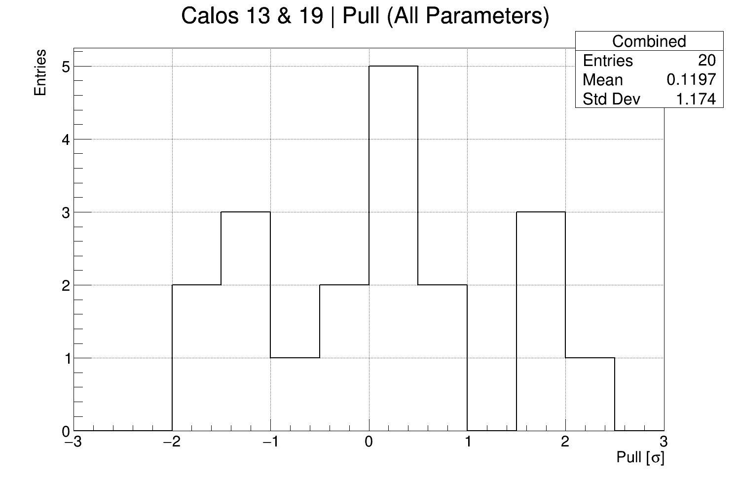
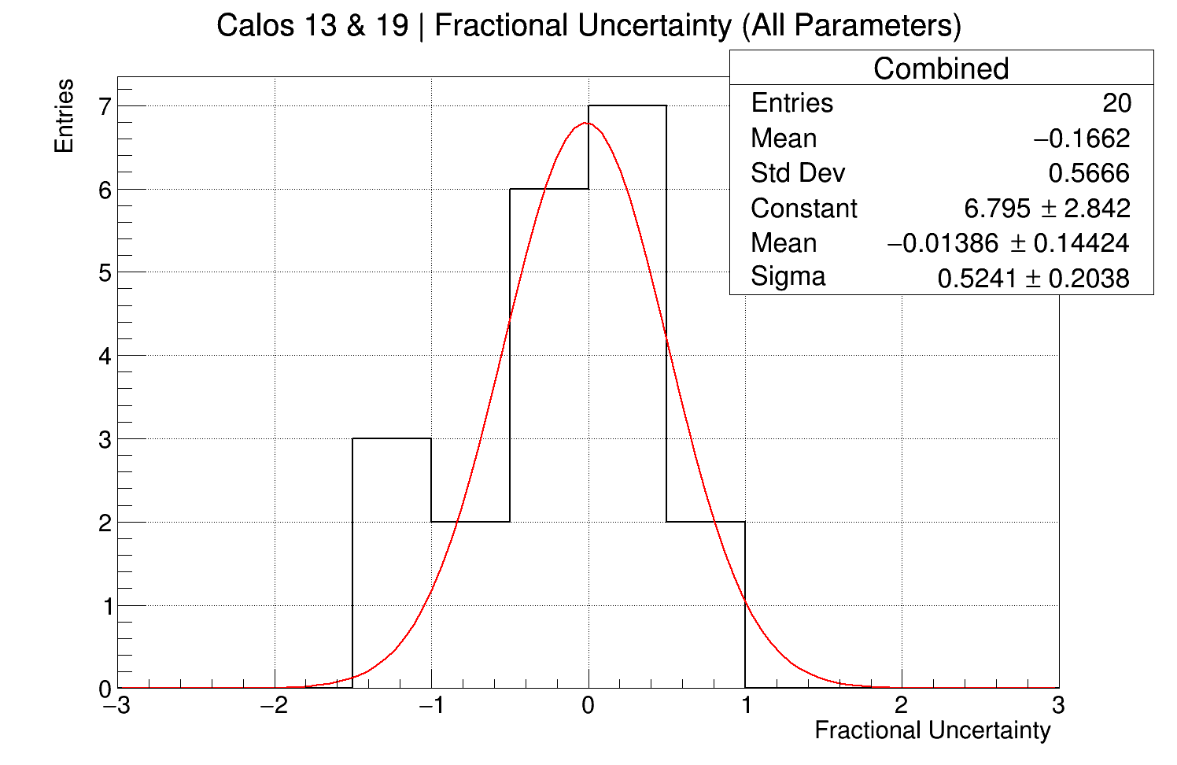
Fit over range 0-42 us
New range wipes out the need for a stat cut
Chi sqr and relative error cuts are sufficient
Might be a good as we can do with 60 hour.

Slide 9
Good Crystal (Calo 13 #22) vs. Bad Crystal (Calo 13 #42)
Idea 1: Have a look at the energy and momentum distributions and understand the difference

Slide 10
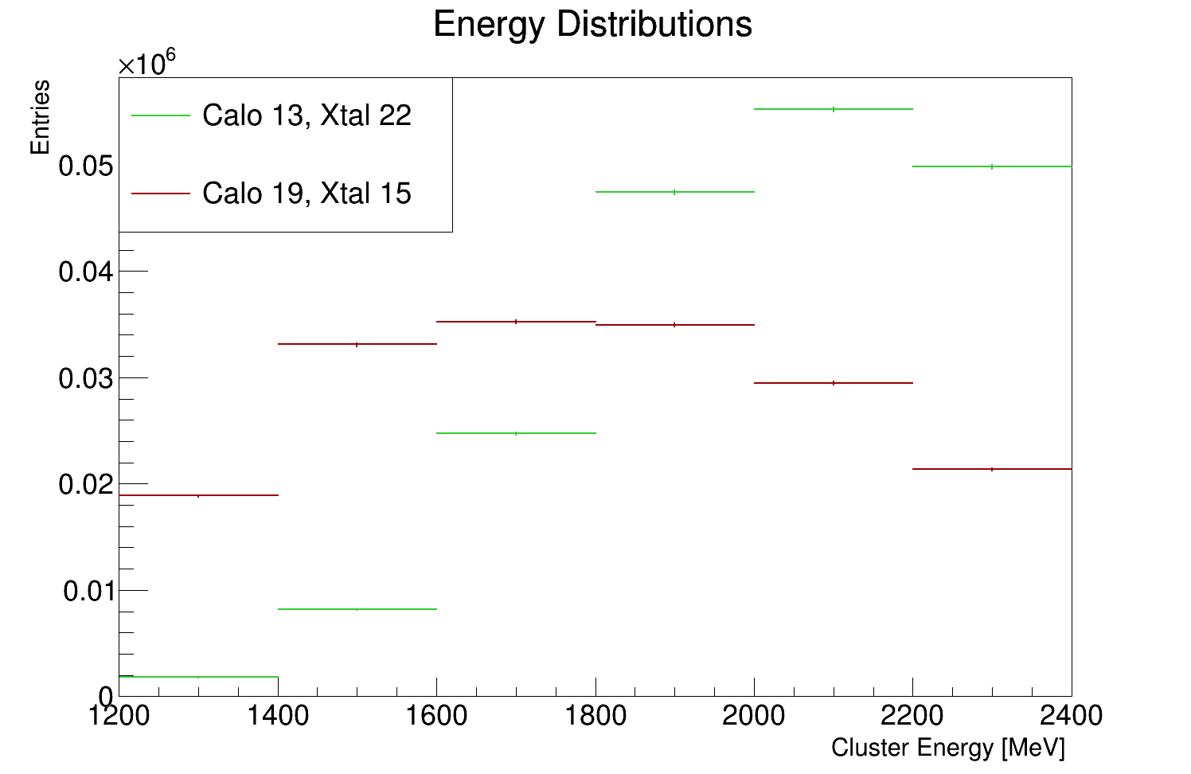
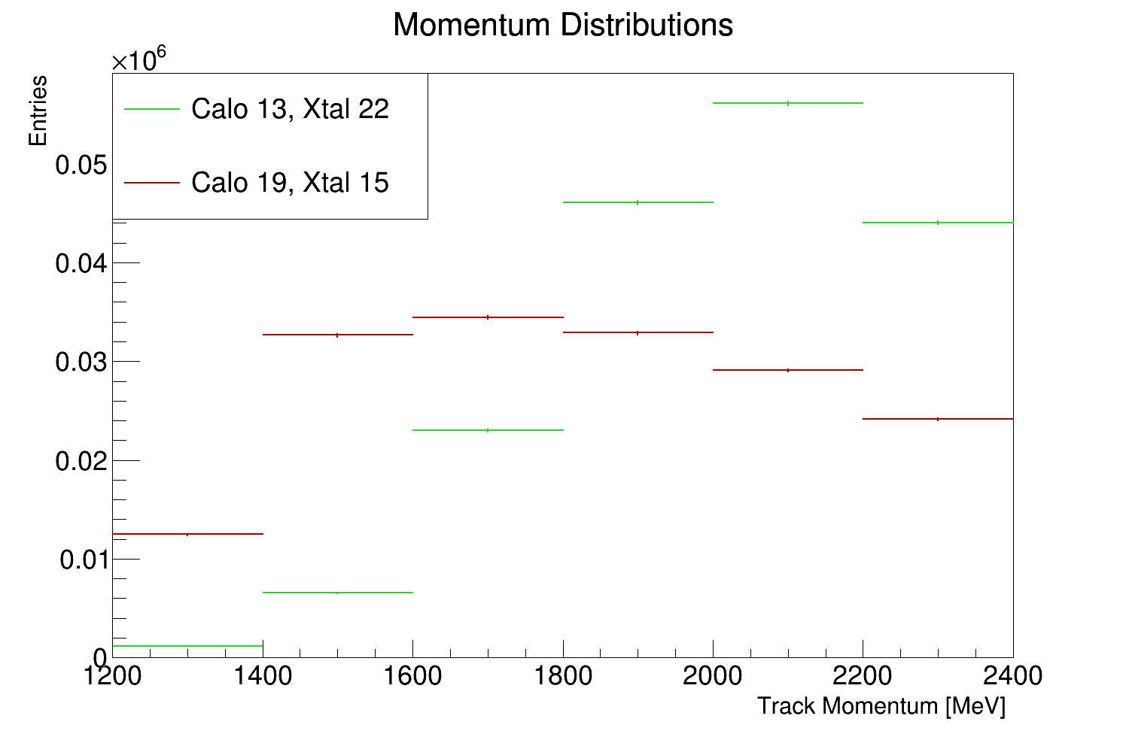
Good Crystal (Calo 13 #22) vs. Bad Crystal (Calo 19 #15)
Idea 1: Have a look at the energy and momentum distributions and understand the difference
Where does this come from?

Slide 11
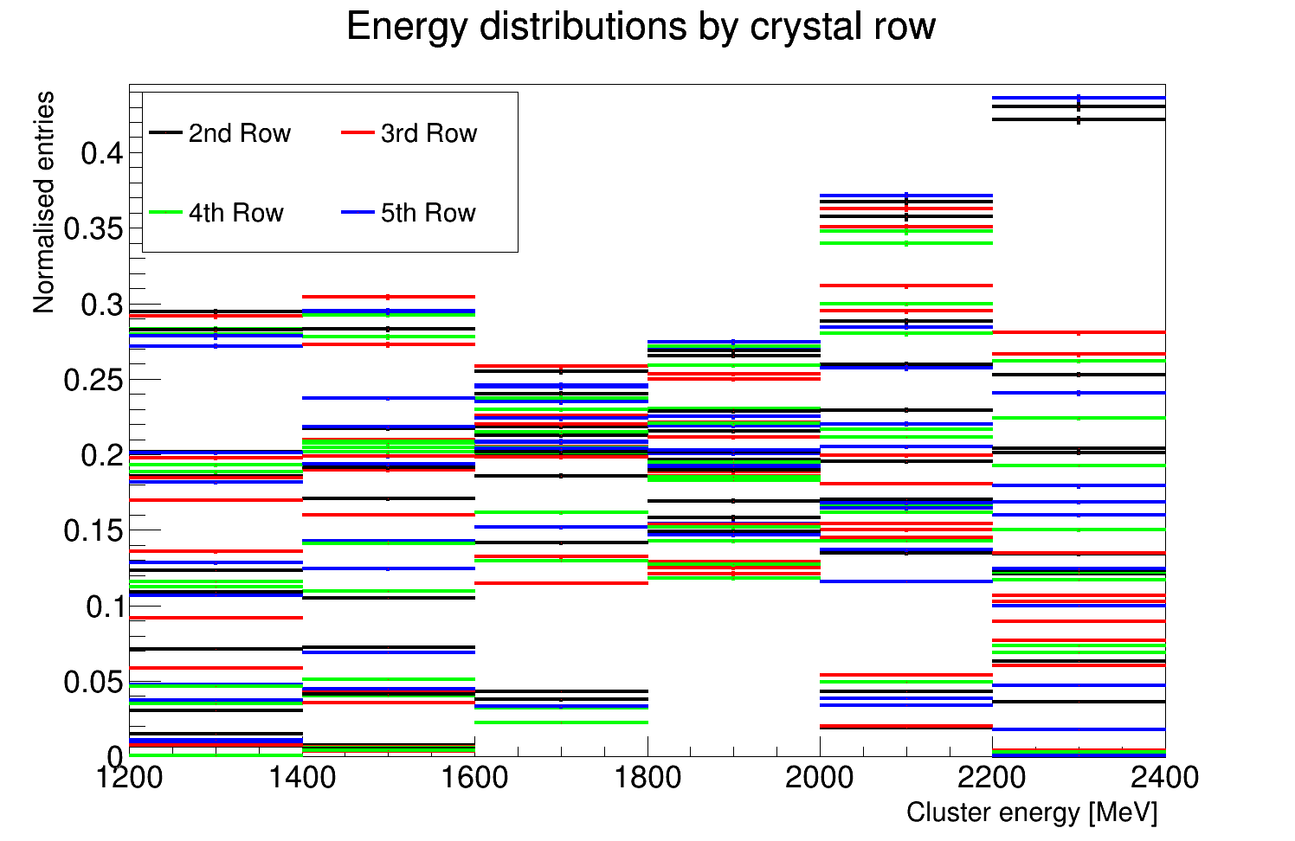
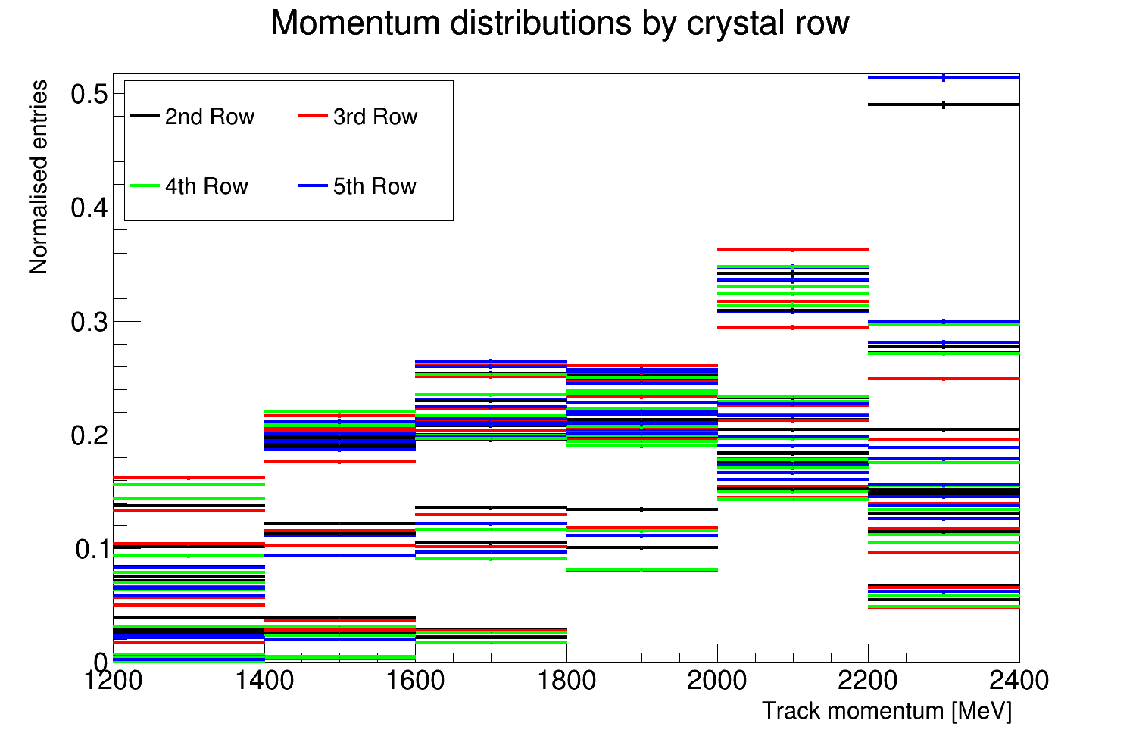
Energy and momentum distributions by row
No real structure going vertically, row by row (to be expected).

Slide 12
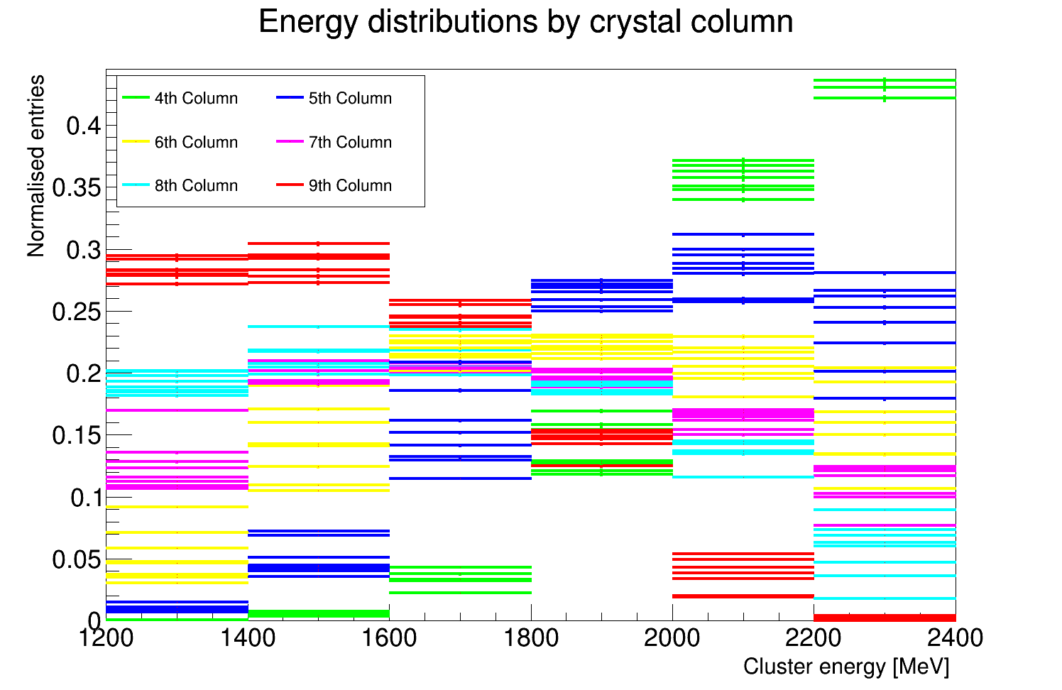
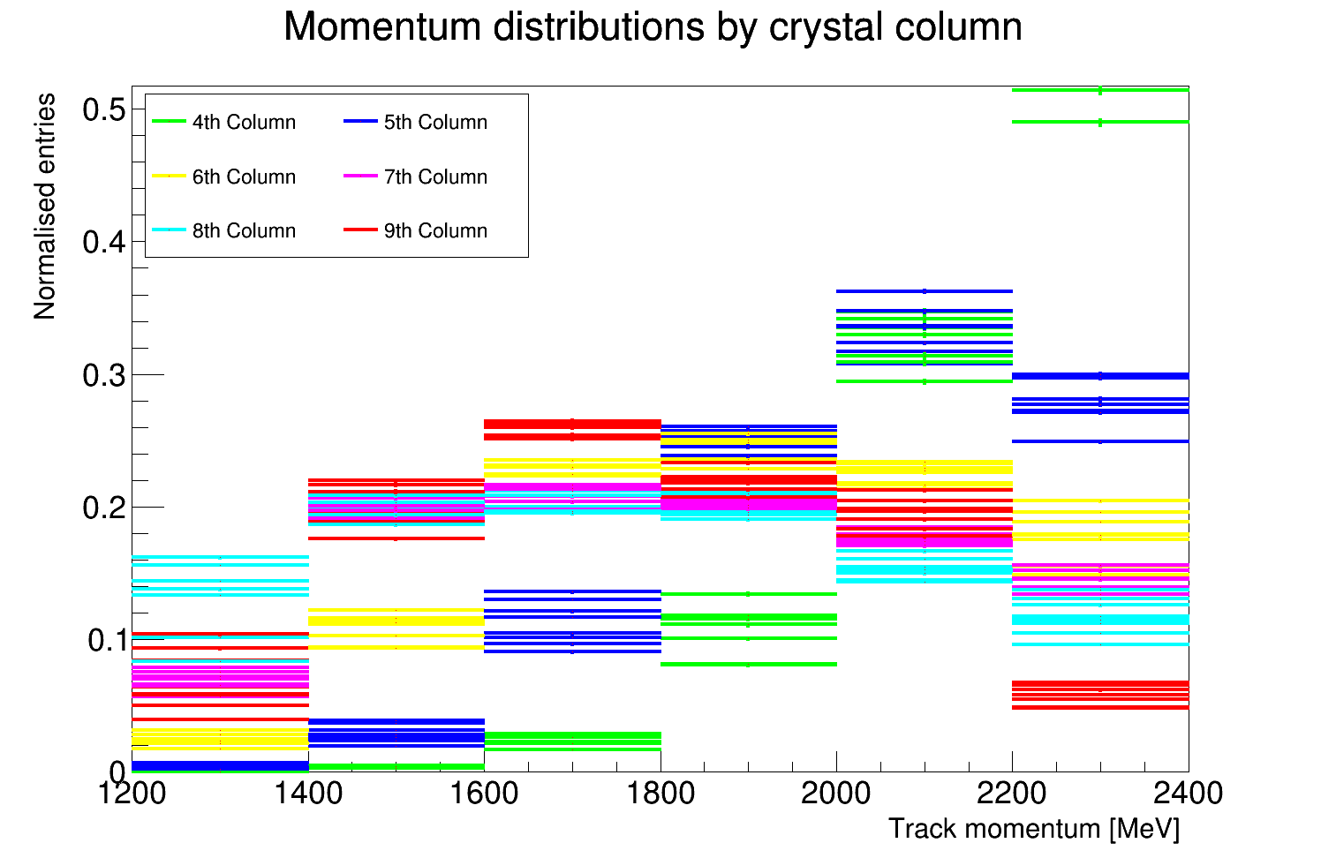
Energy and momentum distributions by column
Definite structure.
As you scan left to right across the calo you see how the momentum/energy drops (indicating more curvature).
Difference on slide 7 is to be expected!

Slide 13
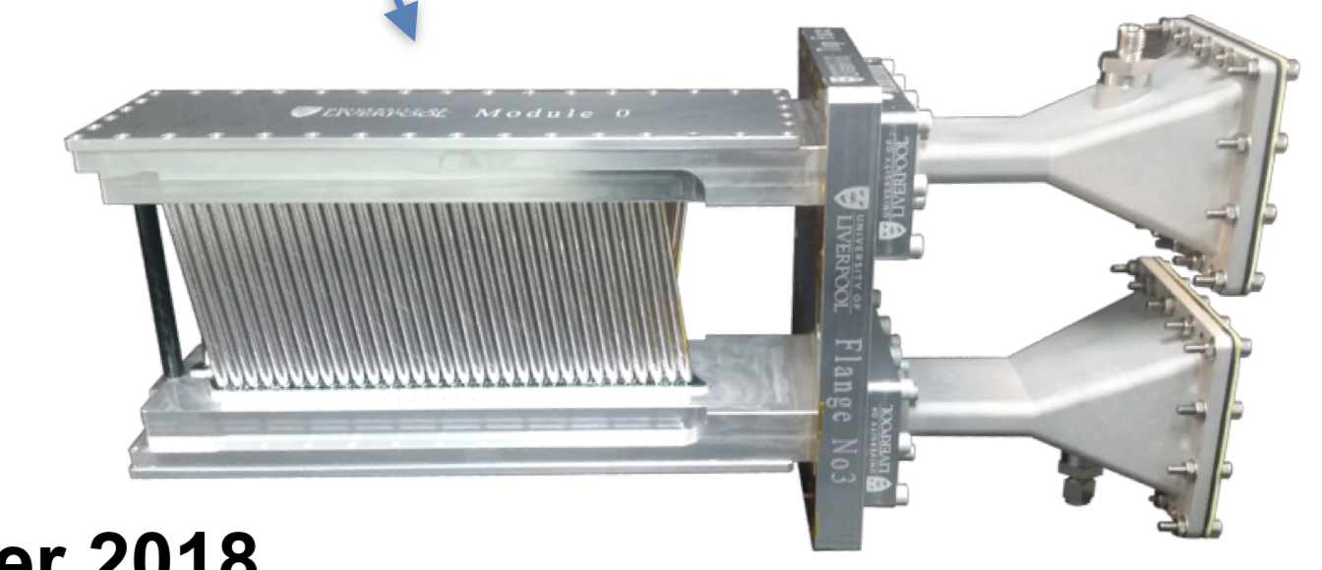
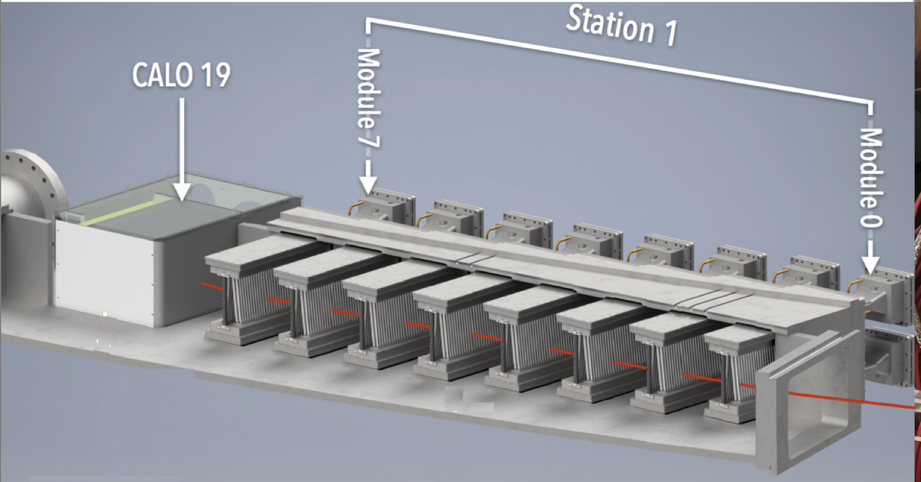
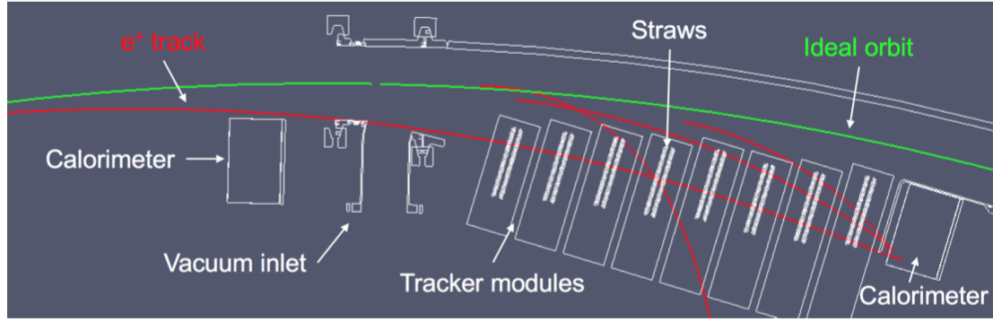
Trackers
Layers of wire under high voltage, encased in straws filled with an argon-ethane gas mix
Provides information about track momentum and position
Two sets of 8 modules, in front of calorimeters 13 and 19.
Very useful for studying systematics as well!
Ionisation -> Charges drift to wires -> Read out and reconstruct -> No worries

Slide 14
Calos
24 Calorimeters
54 Scintillating Crystals per Calo
Tracks can be matched between tracker and calo

Slide 15
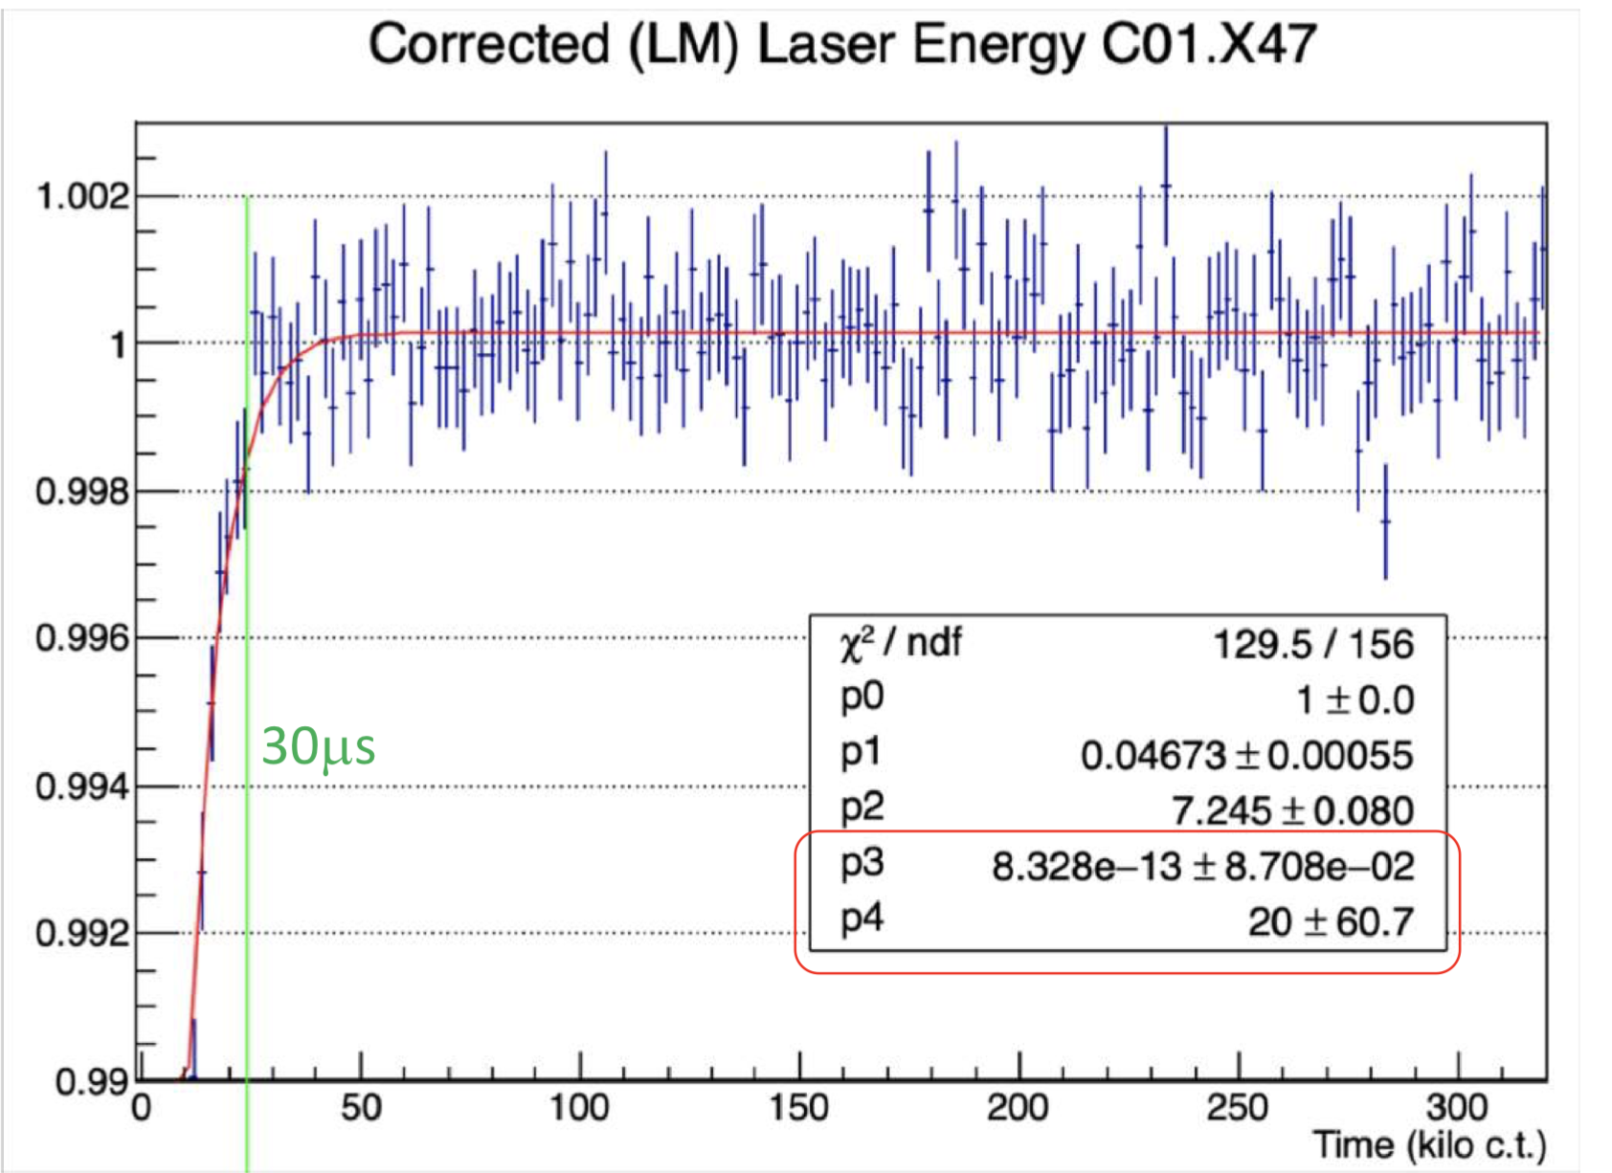
Gain sag!
Sudden drop and subsequent recovery in gain at early times
This is due to bunching after injection saturating the calorimeters
Must be fitted and corrected in processing
Amplitude p₁ and time constant p₂ are used for gain corrections

Slide 16
The E/p ratio
Tracker-calo matched tracks provide a different way to measure gain, so we can perform an independent cross check of the laser.
Gain = measured energy / true energy
E = p, and trackers do not “see” gain sag, so:
Gain = cluster energy (calo) / track momentum (tracker)
Gain = E/p

